Slide 1
Chapter 7: More SQL

Slide 2
Chapter 7 Outline
More Complex SQL Retrieval Queries
Specifying Constraints as Assertions and Actions as Triggers
Views (Virtual Tables) in SQL
Schema Change Statements in SQL

Slide 3
More Complex SQL Retrieval Queries
Additional features allow users to specify more complex retrievals from database:
Derived values
Nested queries
Joined tables
Outer joins
Aggregate functions and grouping

Slide 4
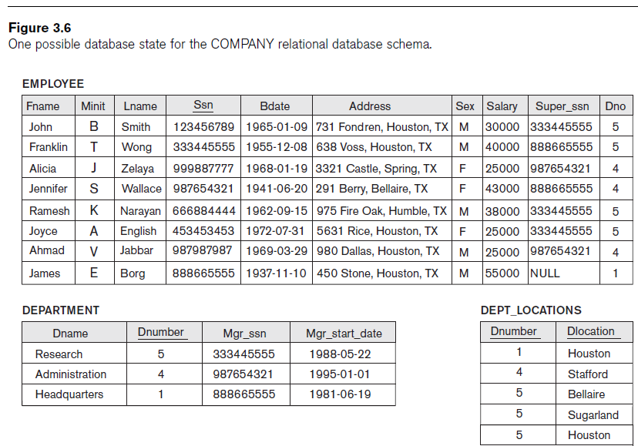
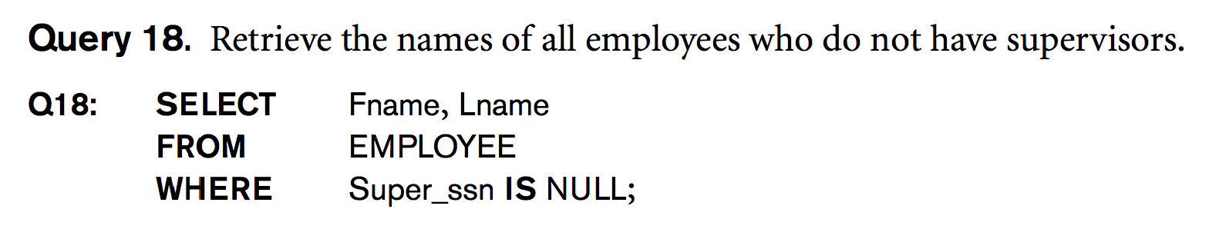
Comparisons Involving NULL
SQL allows queries that check whether an attribute value is NULL
IS NULL or IS NOT NULL
Notes:
SELECT Fname, Lname
FROM Employee
Where Super_ssn IS NULL;

Slide 5
Nested Queries

Slide 6
Nested Queries
Nested in WHERE clause
WHERE [NOT] attribute ⟨comp_op⟩ (subquery)
WHERE [NOT] attribute ⟨comp_op⟩ ANY (subquery)
WHERE [NOT] attribute ⟨comp_op⟩ ALL (subquery)
WHERE attribute [NOT] IN (subquery)
Nested in FROM clause (creating a Table on-the-fly)
FROM (subquery) AS alias
Notes:
“ANY” == “SOME”
Independent (NOT correlated) query

Slide 7
Nested Queries, Tuples, and Set/Multiset Comparisons
Nested queries
Complete select-from-where blocks within WHERE clause of another query
Outer query vs. Inner Query
Comparison operator IN
Compares value v with a set (or multiset) of values V
Evaluates to TRUE if v is one of the elements in V

Slide 8
IN Clause
Comparison set operator IN
Compares value v with a set (or multiset) of values V
Evaluates to TRUE if v is one of the elements in V

Slide 9
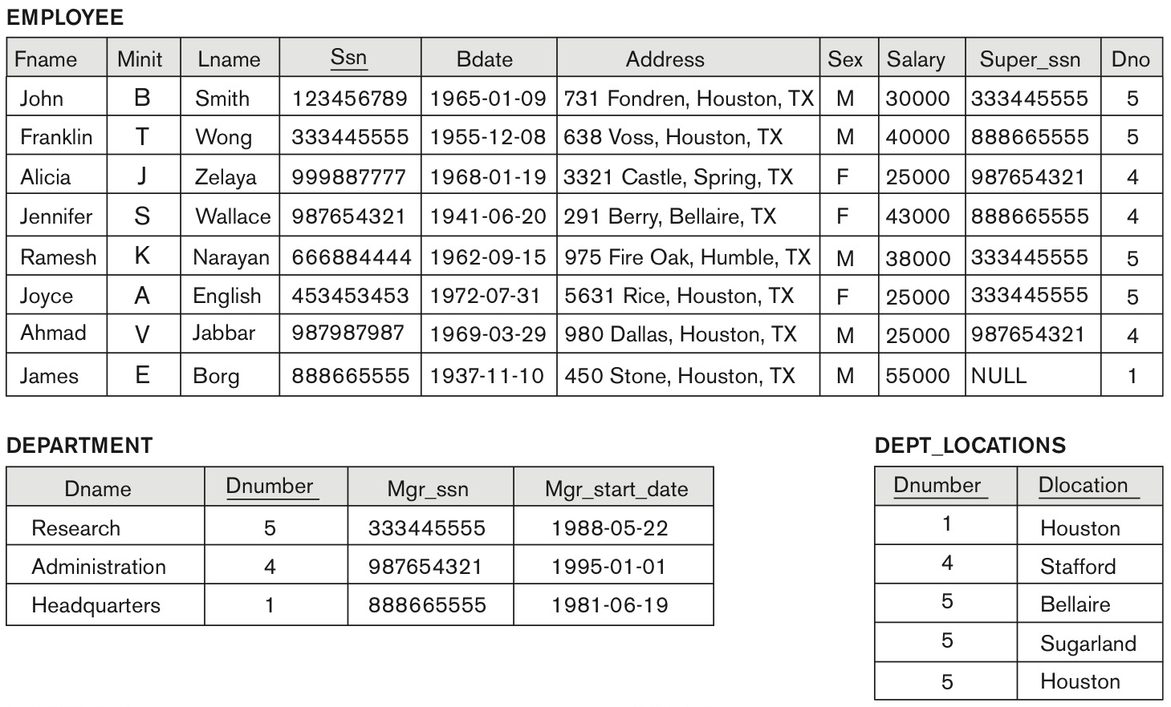
IN Operator with Explicit Set
SELECT * FROM Department WHERE Dnumber IN (1,7,8);

Slide 10
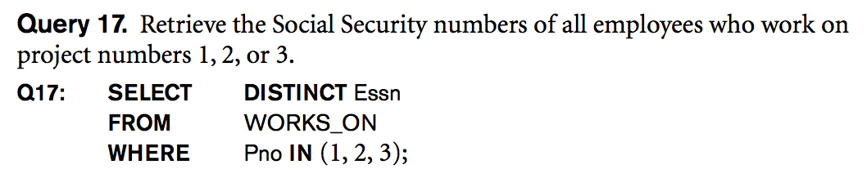
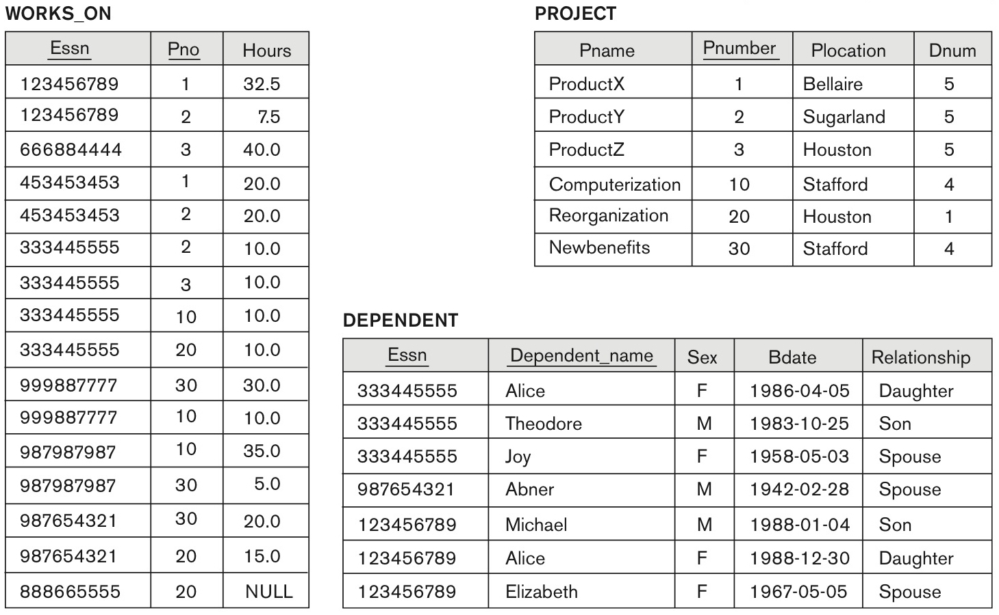
Explicit Sets and Renaming of Attributes in SQL
Can use explicit set of values in WHERE clause

Slide 11
Nested Queries (cont’d.)
Retrieve the name of each employee who has at least one son.
Select Fname, Lname
From Employee
Where Ssn IN (Select Essn
From Dependent
Where relationship = ‘son’);
the result of the subquery is: {‘123456789’, ‘333445555’}
Each of these two ESSNs has at least one son

Slide 12
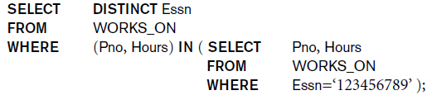
Nested Queries (cont’d.)
Use tuples of values in comparisons,
e.g. (Pno, Hours)
Place them within parentheses
Query: Retrieve the SSN of every employee who had
worked on the same projects and the same number of
hours as the employee with SSN= ‘123456789’
The result of the subquery is: { (1, 32.5), (2, 7.5) }

Slide 13
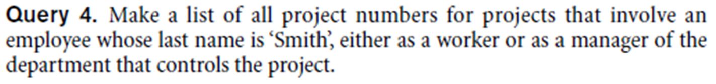
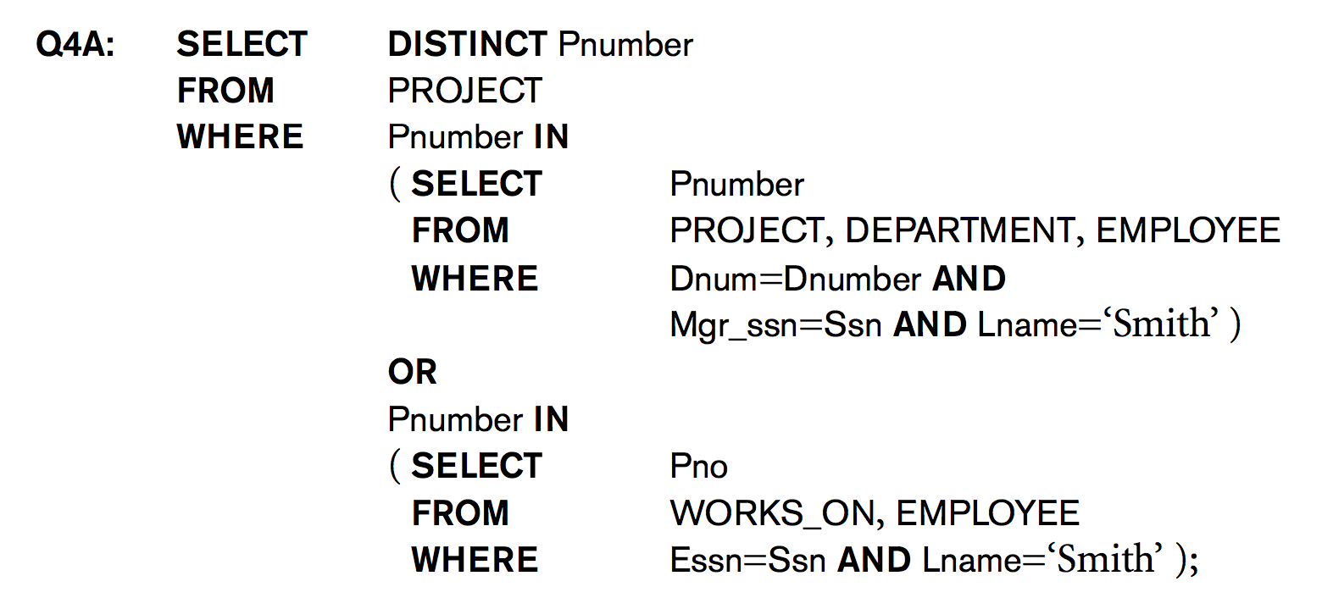
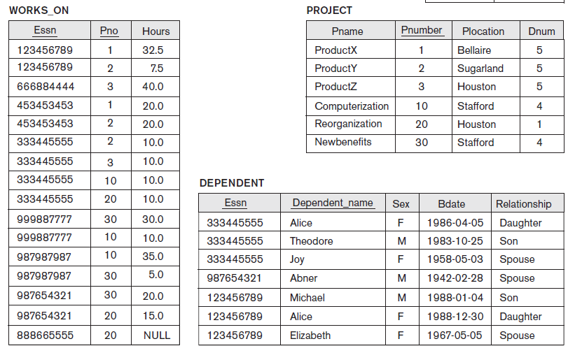
Nested Queries (cont’d.)
UNION
Notes:
#RESUME Feb 18, 2016 Section 001
Domain arity and type must match Range
SELECT DISTINCT Pnumber
FROM Project
WHERE Pnumber IN
(SELECT Pnumber
FROM Project, Department, Employee
WHERE Dnum=Dnumber AND mgrssn=ssn AND Lname = 'Wong')
OR Pnumber IN
(SELECT Pno
FROM Works_on, Employee
WHERE Essn=Ssn AND Lname = 'Wong');

Slide 14
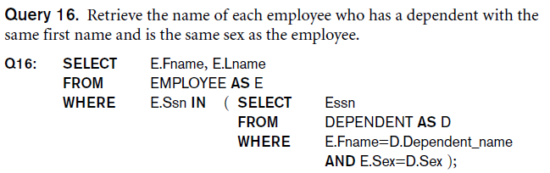
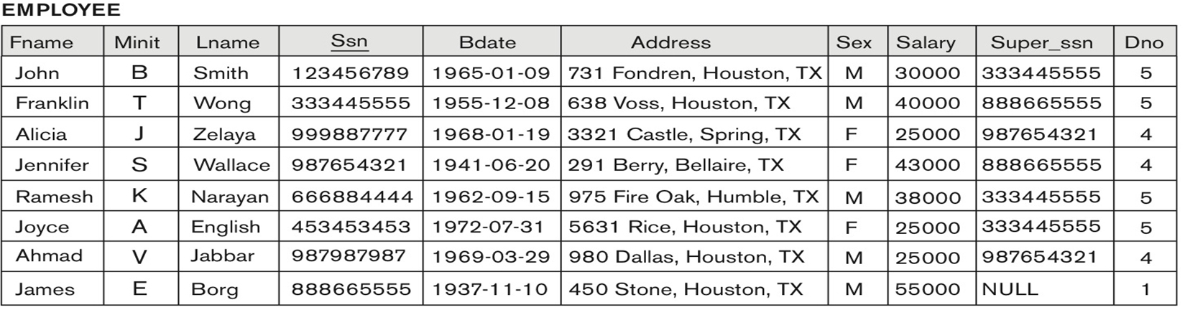
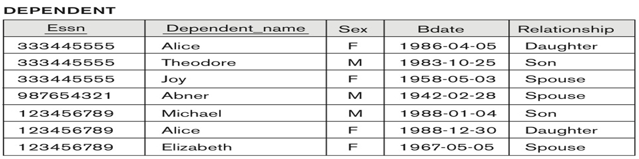


Nested Queries (cont’d.)
Avoid potential errors and ambiguities
Create tuple variables (aliases) for all tables referenced in SQL query
Notes:
For each EMPLOYEE tuple, evaluate the nested query, which retrieves the Essn values for all DEPENDENT tuples with the same sex and name as that EMPLOYEE tuple;
if the Ssn value of the EMPLOYEE tuple is in the result of the nested query, then select that EMPLOYEE tuple.

Slide 15
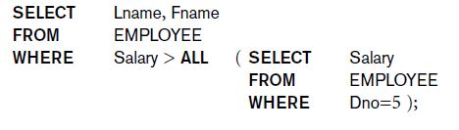
Nested Queries (cont’d.)
Use other comparison operators to compare a single value v
= ANY (or = SOME) operator
Returns TRUE if the value v is equal to some value in the set V and is hence equivalent to IN
Other operators that can be combined with ANY (or SOME): >, >=, <, <=, and <>

Slide 16
Correlated Nested Queries
Correlated nested query
Whenever a condition in the WHERE clause of a nested query references some attribute of a relation declared in the outer query, the two queries are said to be correlated.
We can understand a correlated query better by considering that the nested query is evaluated once for each tuple (or combination of tuples) in the outer query.
For example, we can think of Q16 as follows: For each EMPLOYEE tuple, evaluate the nested query, which retrieves the Essn values for all DEPENDENT tuples with the same sex and name as that EMPLOYEE tuple; if the Ssn value of the EMPLOYEE tuple is in the result of the nested query, then select that EMPLOYEE tuple.
Notes:
Inner query vs. Outer query

Slide 17
The EXISTS Functions in SQL
EXISTS function
Check whether the result of a nested query is empty or not
No comparison with elements of result set!!
EXISTS and NOT EXISTS
Typically used in conjunction with a correlated nested query
Notes:
UNIQUE is different than DISTINCT

Slide 18
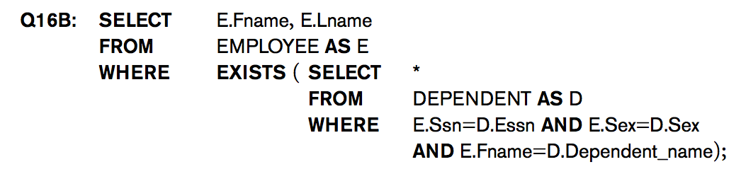
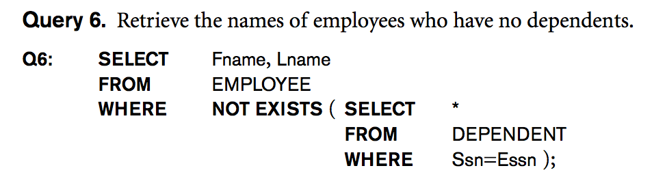


Alternate Query 16 + Query 6

Slide 19
The UNIQUE Functions in SQL
SQL function UNIQUE(Q)
Returns TRUE if there are no duplicate tuples in the result of query Q
SELECT FirstName, LastName
FROM CUSTOMER
WHERE UNIQUE ( SELECT CustomerID
FROM SALES
WHERE SALES.CustomerID = CUSTOMER.CustomerID);
This statement retrieves the names of all customers for whom the SALES table records only one sale.
Notes:
UNIQUE is different than DISTINCT

Slide 20
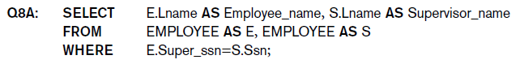
Explicit Sets and Renaming of Attributes in SQL
Renaming of Attributes
Use qualifier AS followed by desired new name
Rename any attribute that appears in the result of a query
Notes:
FIXME: Info exists on earlier slide
SELECT E.Lname AS Employee_name, S.Lname AS Supervisor_name
FROM Employee AS E, Employee AS S
WHERE E.Superssn = S.Ssn;

Slide 21
Joins

Slide 22
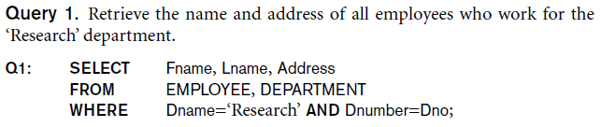
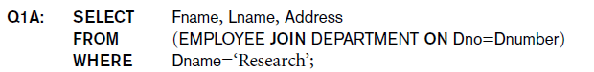
Specifying Joined Tables in the FROM Clause of SQL
The FROM clause in Q1
Joined table
Permits users to specify a table resulting from a join
operation in the FROM clause of a query
Contains a single joined table. JOIN may also be called INNER JOIN
22

Slide 23
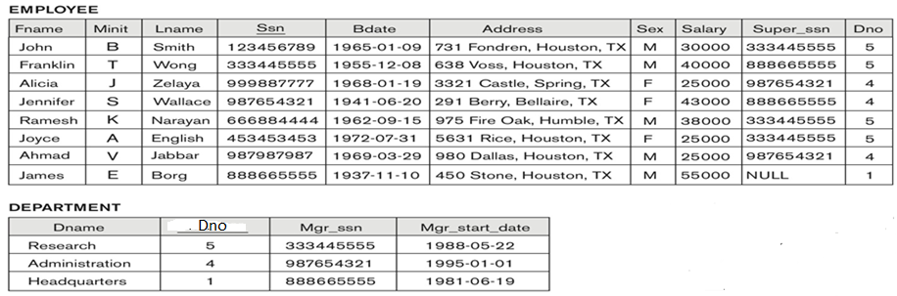
NATURAL JOIN
NATURAL JOIN on two relations R and S
No join condition specified
Is equivalent to an implicit EQUIJOIN condition for each pair of attributes with the same name from R and S
Rename attributes of one relation so it can be joined with another using NATURAL JOIN:
Q1B: SELECT Fname, Lname, Address
FROM (EMPLOYEE NATURAL JOIN DEPARTMENT)
WHERE Dname=‘Research’;
The above works with EMPLOYEE.Dno = DEPT.Dno as an implicit join condition
23

Slide 24
INNER and OUTER Joins
INNER JOIN
Default type of join in a joined table
Tuple is included in the result only if a matching tuple exists in the other relation
LEFT OUTER JOIN
Every tuple in left table must appear in result
If no matching tuple
Padded with NULL values for attributes of right table
RIGHT OUTER JOIN
Every tuple in right table must appear in result
If no matching tuple
Padded with NULL values for attributes of left table
24

Slide 25
SQL Inner Joins
SELECT S.name, E.classid
FROM S JOIN E ON S.sid=E.sid
S
S.name | S.sid
Jones | 11111
Smith | 22222
Brown | 33333
E
E.sid | E.classid
11111 | History105
11111 | DataScience194
22222 | French150
44444 | English10
S.name | E.classid
Jones | History105
Jones | DataScience194
Smith | French150
25

Slide 26
SQL Inner Joins
SELECT S.name, E.classid
FROM S JOIN E ON S.sid=E.sid
S
S.name | S.sid
Jones | 11111
Smith | 22222
Brown | 33333
E
E.sid | E.classid
11111 | History105
11111 | DataScience194
22222 | French150
44444 | English10
S.name | E.classid
Jones | History105
Jones | DataScience194
Smith | French150
Unmatched keys
26
Notes:
Missing (unmatched) key values

Slide 27
What kind of Join is this?
SELECT S.name, E.classid
FROM S ?? E ON S.sid=E.sid
S
S.name | S.sid
Jones | 11111
Smith | 22222
Brown | 33333
E
E.sid | E.classid
11111 | History105
11111 | DataScience194
22222 | French150
44444 | English10
S.name | E.classid
Jones | History105
Jones | DataScience194
Smith | French150
Brown | NULL
27
Notes:
Missing (unmatched) key values

Slide 28
SQL Joins
SELECT S.name, E.classid
FROM S LEFT OUTER JOIN E ON S.sid=E.sid
S
S.name | S.sid
Jones | 11111
Smith | 22222
Brown | 33333
E
E.sid | E.classid
11111 | History105
11111 | DataScience194
22222 | French150
44444 | English10
S.name | E.classid
Jones | History105
Jones | DataScience194
Smith | French150
Brown | NULL
28
Notes:
Missing (unmatched) key values

Slide 29
SQL Joins
SELECT S.name, E.classid
FROM S RIGHT OUTER JOIN E ON S.sid=E.sid
S
S.name | S.sid
Jones | 11111
Smith | 22222
Brown | 33333
E
E.sid | E.classid
11111 | History105
11111 | DataScience194
22222 | French150
44444 | English10
S.name | E.classid
Jones | History105
Jones | DataScience194
Smith | French150
NULL | English10
29
Notes:
Missing (unmatched) key values

Slide 30
SQL Joins
SELECT S.name, E.classid
FROM S RIGHT OUTER JOIN E ON S.sid=E.sid
S
S.name | S.sid
Jones | 11111
Smith | 22222
Brown | 33333
E
E.sid | E.classid
11111 | History105
11111 | DataScience194
22222 | French150
44444 | English10
S.name | E.classid
Jones | History105
Jones | DataScience194
Smith | French150
NULL | English10
30
Notes:
Missing (unmatched) key values

Slide 31
SQL Joins
SELECT S.name, E.classid
FROM S ? JOIN E ON S.sid=E.sid
S
S.name | S.sid
Jones | 11111
Smith | 22222
Brown | 33333
E
E.sid | E.classid
11111 | History105
11111 | DataScience194
22222 | French150
44444 | English10
S.name | E.classid
Jones | History105
Jones | DataScience194
Smith | French150
NULL | English10
Brown | NULL
31
Notes:
Missing (unmatched) key values

Slide 32
SQL Joins
SELECT S.name, E.classid
FROM S FULL OUTER JOIN E ON S.sid=E.sid
S
S.name | S.sid
Jones | 11111
Smith | 22222
Brown | 33333
E
E.sid | E.classid
11111 | History105
11111 | DataScience194
22222 | French150
44444 | English10
FULL OUTER JOIN – combines result of LEFT and RIGHT OUTER JOIN
S.name | E.classid
Jones | History105
Jones | DataScience194
Smith | French150
NULL | English10
Brown | NULL
32
Notes:
Missing (unmatched) key values

Slide 33
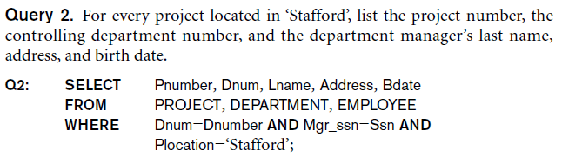
Multiway JOIN in the FROM clause
Can nest JOIN specifications for a multiway join:
Q2A: SELECT Pnumber, Dnum, Lname, Address, Bdate
FROM ((PROJECT JOIN DEPARTMENT ON Dnum=Dnumber)
JOIN EMPLOYEE ON Mgr_ssn=Ssn)
WHERE Plocation=‘Stafford’;
33

Slide 34
Aggregate Functions in SQL
Used to summarize information from multiple tuples into a single-tuple summary
Built-in aggregate functions
COUNT, SUM, MAX, MIN, and AVG
Grouping
Create subgroups of tuples before summarizing
To select entire groups, HAVING clause is used
Aggregate functions can be used in the SELECT clause or in a HAVING clause
34

Slide 35
Renaming Results of Aggregation
Following query returns a single row of computed values from EMPLOYEE table:
Q19: SELECT SUM (Salary), MAX (Salary), MIN (Salary), AVG (Salary)
FROM EMPLOYEE;
The result can be presented with new names:
Q19A: SELECT SUM (Salary) AS Total_Sal, MAX (Salary) AS Highest_Sal, MIN (Salary) AS Lowest_Sal,
AVG (Salary) AS Average_Sal
FROM EMPLOYEE;
35

Slide 36
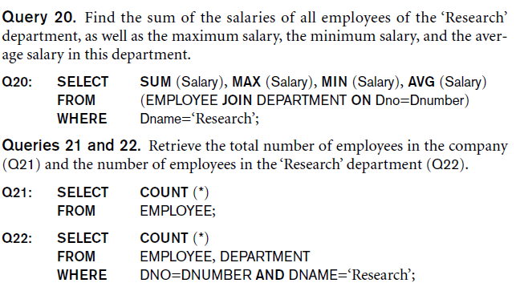
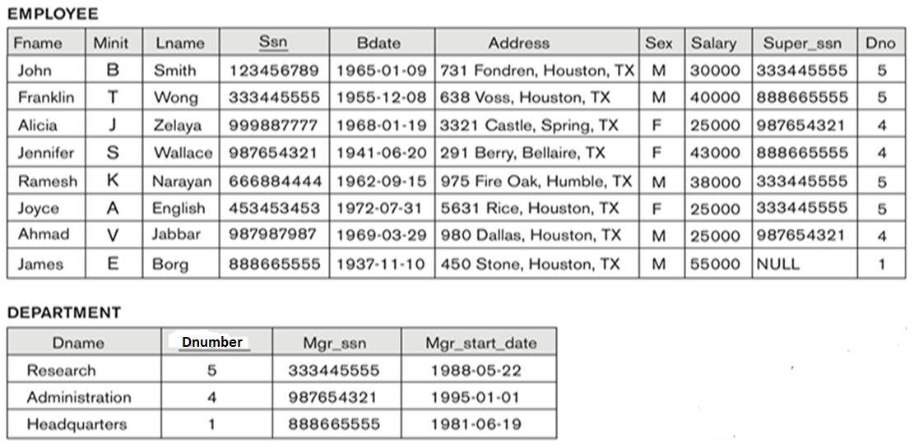
Aggregate Functions in SQL (cont’d.)
NULL values are discarded when aggregate functions are applied to a particular column
36

Slide 37
Grouping: The GROUP BY Clause
Partition relation into subsets of tuples
Based on grouping attribute(s)
Apply function to each such group independently
GROUP BY clause
Specifies grouping attributes
COUNT (*) counts the number of rows in the group
37

Slide 38
Examples of GROUP BY
The grouping attribute must appear in the SELECT clause:
Q24: SELECT Dno, COUNT (*), AVG (Salary)
FROM EMPLOYEE
GROUP BY Dno;
GROUP BY may be applied to the result of a JOIN:
Retrieve each project number, its name, and how many employees
works on it.
Q25:SELECT Pnumber, Pname, COUNT (*)
FROM PROJECT, WORKS_ON
WHERE Pnumber=Pno
GROUP BY Pnumber, Pname;
38

Slide 39
Grouping: The GROUP BY and HAVING Clauses (cont’d.)
HAVING clause
Provides a condition to select or reject an entire group:
Query 26. For each project on which more than two employees work, retrieve the project number, the project name, and the number of employees who work on the project.
Q26: SELECT Pnumber, Pname, COUNT (*)
FROM PROJECT, WORKS_ON
WHERE Pnumber=Pno
GROUP BY Pnumber, Pname
HAVING COUNT (*) > 2;
39

Slide 40
Exercises
Retrieve the name of each employee who has at least 3 dependents.
Retrieve the name of each department that has at least two locations
Retrieve the name of each employee who had worked at least 50 hours (on all the projects that he/she had worked on)
40

Slide 41
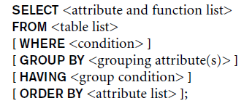
EXPANDED Block Structure of SQL Queries
41

Slide 42
Specifying Constraints as Assertions and Actions as Triggers
Semantic Constraints: The following are beyond the scope of the EER and relational model
CREATE ASSERTION
Specify additional types of constraints outside scope of built-in relational model constraints
CREATE TRIGGER
Specify automatic actions that database system will perform when certain events and conditions occur
42

Slide 43
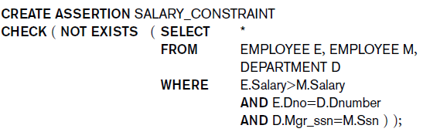
Specifying General Constraints as Assertions in SQL
Condition can be anything allowed in a WHERE clause.
Constraint is tested whenever any (!) of the referenced tables is modified.
Violating modifications are rejected.
For example, to specify the constraint that the salary of an employee must not be greater than the salary of the manager of the department that the employee works for in SQL, we can write the following assertion:
43

Slide 44
Example: assertions
Sailors
Boats
bid | colour
101 | green
103 | red
Reserves
44

Slide 45
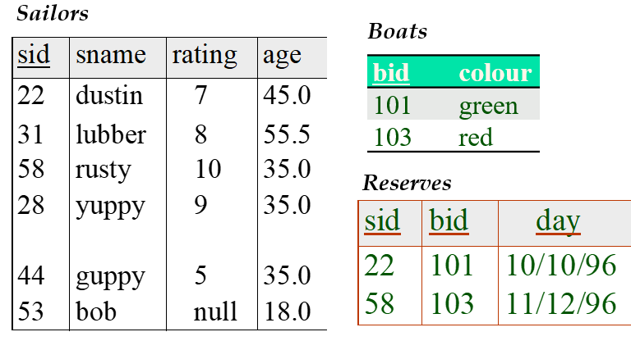
Assertions
Constraint:
Number of boats plus number of sailors
is < 100.
CREATE ASSERTION smallClub
CHECK
( (SELECT COUNT (S.sid) FROM Sailors S)
+ (SELECT COUNT (B.bid) FROM Boats B) < 100 );
Constraint:
Number of reservations per sailor is < 10.
CREATE ASSERTION notTooManyReservations
CHECK (SELECT COUNT (*) FROM Reserves GROUP BY sid) < 10);
45
Notes:
9

Slide 46
Views (Virtual Tables) in SQL
Concept of a view in SQL
Single table derived from other tables called the defining tables
Considered to be a virtual table that is not necessarily populated
46

Slide 47
Specification of Views in SQL
CREATE VIEW command
Give table 1) name, 2) list of attribute names, 3) and a query to specify the contents of the view
In V1, attributes retain the names from base tables.
47

Slide 48
Specification of Views in SQL
CREATE VIEW command
Give table 1) name, 2) list of attribute names, 3) and a query to specify the contents of the view
In V2, attributes are assigned names
48

Slide 49
Specification of Views in SQL (cont’d.)
Once a View is defined, SQL queries can use the View relation in the FROM clause
View is always up-to-date
Responsibility of the DBMS and not the user
DROP VIEW command
Dispose of a view
49

Slide 50
View Update
Update on a view defined on a single table without any aggregate functions
Can be mapped to an update on underlying base table- possible if the primary key is preserved in the view
Update not permitted on aggregate views. E.g.,
UV2: UPDATE DEPT_INFO
SET Total_sal=100000
WHERE Dname=‘Research’;
cannot be processed because Total_sal is a computed value in the view definition
Create view DEPT_INFO (Dname, Total_sal)
As select Dname, sum(salary)
From Department, Employee
Where Dnumber = Dno
Group by Dname;
50

Slide 51
Views as authorization mechanism
SQL query authorization statements (GRANT and REVOKE)
Views can be used to hide certain attributes or tuples from unauthorized users
E.g., For a user who is only allowed to see employee information for those who work for department 5, he may only access the view DEPT5EMP:
CREATE VIEW DEPT5EMP AS
SELECT *
FROM EMPLOYEE
WHERE Dno = 5;
51

Slide 52
The DROP Command
DROP command
Used to drop named schema elements, such as tables, domains, or constraint
Drop behavior options:
CASCADE and RESTRICT
Example:
DROP SCHEMA COMPANY CASCADE;
This removes the schema and all its elements including tables, views, constraints, etc.
52

Slide 53
The ALTER table command
Alter table actions include:
Adding or dropping a column (attribute)
Changing a column definition
Adding or dropping table constraints
Example:
ALTER TABLE COMPANY.EMPLOYEE ADD COLUMN Job VARCHAR(12);
53

Slide 54
Dropping Columns, Default Values
To drop a column
Choose either CASCADE or RESTRICT
CASCADE would drop the column from views etc. RESTRICT is possible if no views refer to it.
ALTER TABLE COMPANY.EMPLOYEE DROP COLUMN Address CASCADE;
Default values can be dropped and altered :
ALTER TABLE COMPANY.DEPARTMENT ALTER COLUMN Mgr_ssn DROP DEFAULT;
ALTER TABLE COMPANY.DEPARTMENT ALTER COLUMN Mgr_ssn SET DEFAULT ‘333445555’;
54

Slide 55
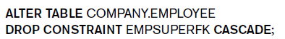
The ALTER Command (cont’d.)
Change constraints specified on a table
Add or drop a named constraint

Slide 56
ALTER Commands
Add a new column to a table
Modify an existing table column
ALTER TABLE table_name CHANGE old_column_name new_column_definition;
ALTER TABLE Employee CHANGE Dno Dnumber INT NOT NULL;
ALTER TABLE foo ADD COLUMN name text;

Slide 57
Summary
Complex SQL:
Nested queries,
Joined tables, outer joins,
Aggregate functions,
Grouping
CREATE ASSERTION and CREATE TRIGGER
Views
Virtual or derived tables
CREATE VIEW view_name AS (query)

